Slide 1
Virtual Reference:
Trends on International, National, and State Levels
Anthony S. Chow, PhD – strategicperformancesystems@gmail.com
Rebecca A. Croxton, MLIS
Strategic Performance Systems
http://www.ncstrategicperformancesystems.com/

Slide 2
Project Overview
Five-month study funded by the State Library of North Carolina in 2014
Two Guiding Goals:
Identify & evaluate other statewide reference service models
Provide recommendations to the State Library for future operation of its statewide reference service - NCKnows.

Slide 3
NCknows Overview & Performance
NCknows: North Carolina’s statewide virtual reference service (2003-12th year)
Administration: NCLive – formely State Library of North Carolina with help from a committee of librarians and directors from NC libraries
Staffing: Academic and public librarians from across North Carolina
Hours: 24/7 (except Sat/Sun Midnight - 8 AM)
Usage: Continues to grow annually (160% increase from 2011-2012 to 28,016 transactions/year)
Users: 2011 to 2014 - 33% from academic libraries, 23.5% public libraries, 22% from NCLive, NCknows, NCpedia, K-12, and unknown.
Operating Costs: $163,000 to operate NCknows in 2013.
Funding: LSTA grant awarded by the Institute of Museum and Library Services.

Slide 4
Mixed Methods Study Design
Participants: 340 participants provided input in a statewide study of NCknows and nationwide and international study of virtual references
Data Collection Methods & Sources:
Literature Review (22 relevant studies identified)
Environmental scan of all 50 states
Interviews (n=5)
Focus Groups (n=4)
Surveys (n=6)

Slide 5
Goal 1:
Identify & evaluate other models for statewide reference services

Slide 6
Literature Review - 22 articles selected for review regarding statewide virtual reference services funding models, staffing models, and current trends relating to virtual reference.
Nationwide Analysis - Examination of 50 States, 2 Canadian Provinces, and UK with regard to statewide / collaborative services offered by these entities.
Goal 1
Data Sources

Slide 7
National & International Trends
Prevalence:
30% of states in the U.S. provide statewide virtual reference services
Number of statewide services in decline - participating libraries choosing to provide their own local support
Funding:
LSTA funding only
Consortia funding only
Combination - LSTA & Consortia
Staffing Models:
< 24/7 w/ collaborative partner volunteers
24/7 w/ collaborative partner volunteers during business hours / outsourced after hrs
Management Models:
27.8% managed by State Libraries
22.2% managed by consortia
22.2% managed by public library
22.2% managed by a private company
Usage Patterns (# transactions/year)
22.2%: < 10,000
5.6% : 10,001 - 19,999
22.2% : 20,000 - 39,999
33.3%: > 40,000
NCknows: 29,708 transactions in 2013
Service Hours:
77.22% offer 24/7

Slide 8
Email offered by most virtual reference services.
NCknows staffing model is prevalent model.
Four predominant management models (managed by state library, consortium, private company, or public library
LSTA & Consortia funding predominant funding models
Local support & desire to serve local library patrons biggest issue for statewide VRS
Key Findings - Goal 1
Goal 1: Identification and Evaluation of Other Models for Statewide Virtual Services

Slide 9
Goal 2:
Recommendations future operational models for NCknows.

Slide 10
Interviews (n=5) - Directors of NCknows, NCLive, Florida’s statewide virtual reference, and Durham County Library Systems Resource & Finance Officer
Focus Groups (n=4)
State Library of NC Staff (n=3)
NCknows staff (n=5)
Academic Library Directors (n=10),
Public LIbrary Directors (n=5).
Surveys (n=6)
National survey of State Library VRS (n=33)
Patron survey (n=73)
NCknows staff survey (n=88)
NCknows staff follow-up survey (n=38)
Library administrator survey (n=18)
NCknows transaction log survey (n=840) NCknows,
Goal 2
Data Sources

Slide 11
Stakeholder Perceptions
Patrons (n=73):
1. Want to see virtual reference continue (M=6.8 out of 7)
2. Are satisfied with NCknows (M=6.6)
3. Find it relevant to their needs (M=6.5)
4. Find it is efficient (M=6.4) and easy-to-use (M=6.4)
5. Use NCknows primarily for:
-Reference questions (80%)
-Factual questions (43%)
-Technology support (14%)
-Classroom support (14%)
“This service allows me to complete my research at all hours of the day. It helps me attain by education goals in a timely manner.” - North Carolina Library Patron, August 2014

Slide 12
Stakeholder Perceptions
“Patrons are often amazed at how much they can get from the service and delighted to have access beyond the library's base hours. My library's patrons are delighted at the idea of remote, all-hours assistance.”(NCknows staff, August 2014)
Staff (n=88):
Staff, volunteer, & after hours staff would like to see NCknows continue (M=6.4 out of 7)
Feel it is an important part of patron’s library experience (M=6.2)
Feel it is relevant for meeting patron needs (M=6.1)
90% feel virtual reference will increase in the future.
CONVENIENCE is the number one word to describe NCknows

Slide 13
Stakeholder Perceptions
Having access to virtual reference help is very needed by smaller universities whose staff may not have the expertise to answer questions in some of the specialized fields. (Library Administrator, August 2014)
Library Administrators (n=18):
Believe virtual reference is an important part of of a library patron’s experience and would like to see the service continue (M=6.4 out of 7)
Believe virtual reference is relevant to providing patron services (M=5.9)
Are satisfied with NCknows (M=5.7).

Slide 14
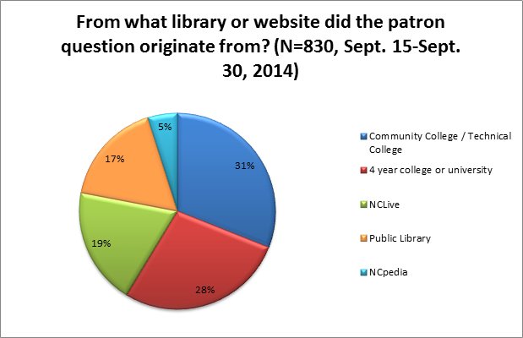
North Carolina - Statewide Trends
Academic Libraries make up the largest patron user base (59%).

Slide 15
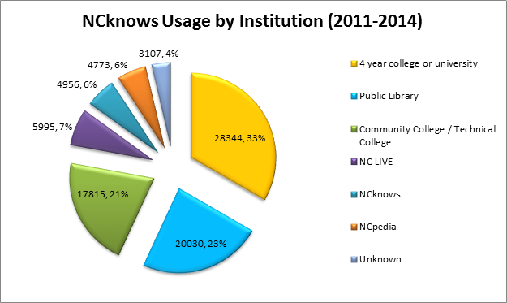
North Carolina - Statewide Trends
Four year colleges and public libraries represent the largest usage of NCknows by institution type.
Note: The top 17 of 158 library users account for 76% of all transactions.

Slide 16
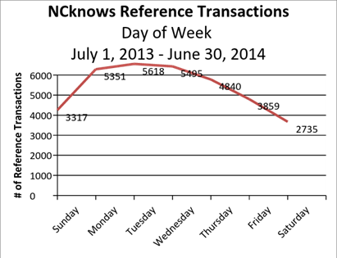
North Carolina - Statewide Trends
Mondays, Tuesdays, and Wednesdays are the busiest days of the week for NCknows.
Sat. is the slowest day.

Slide 17
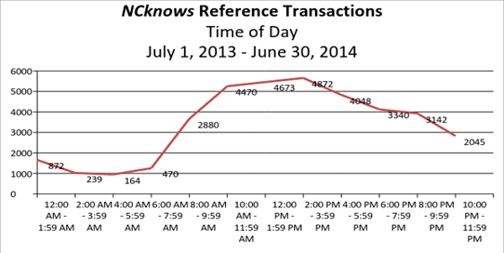
North Carolina - Statewide Trends
Busiest time of day is 10:00 AM - 4:00 PM.

Slide 18
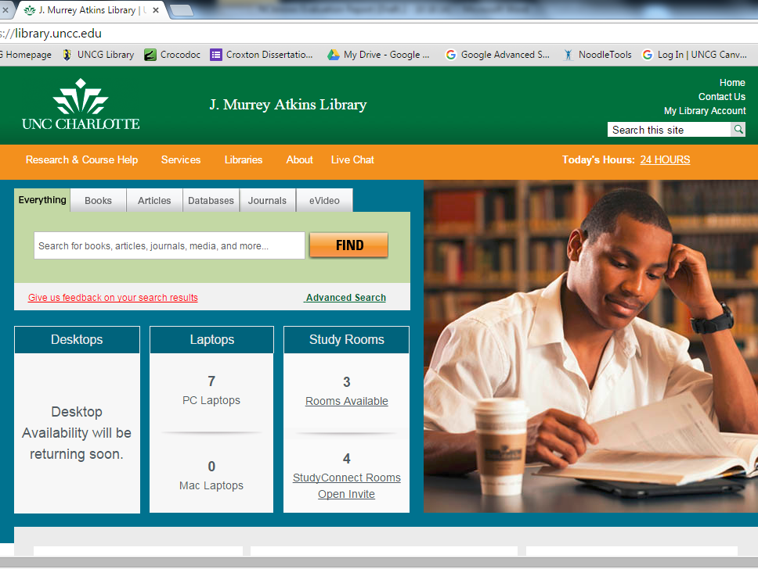
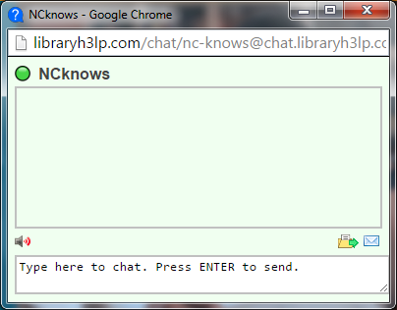
At UNC-Charlotte’s Atkins Library, patrons wishing to chat live with a librarian after regular business hours are automatically directed to an NCknows pop-up chat window.

Slide 19
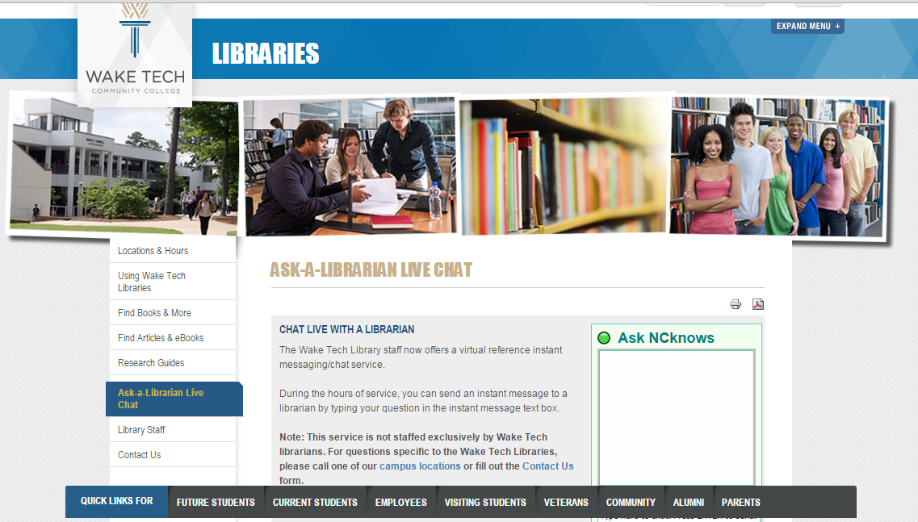
At Wake Tech Community College, Ask NCknows is available 24/7.

Slide 20
Key Findings - Goal 2
NCknows is a valued service by users, librarians, and library administration.
NCknows has high return-on-investment and social-value.
North Carolina libraries have expressed a commitment to collaborate and partner with another to help provide a mutually beneficial service that will enable all libraries to provide 24/7 virtual reference services for their patrons.
Of the 158 libraries that use NCknows, a small number of academic and public libraries represent the majority of all transactions.
Business hours during the business week are show time.
Goal 2: Provide recommendations for future operation of NCKnows.

Slide 21
NCknows - SWOT Analysis
Strengths Valued service by Stakeholders High ROI 12 years of continued service Strong usage from participating libraries High number of transactions based on national comparisons Strong core and tradition of volunteer service | Opportunities Increased cooperation among libraries to help create new funding model and partnership Increased marketing and outreach Increased usage and support for patrons state-wide Provide increased suite of services Increased quality and consistency of support
Weaknesses Marketing Tension between local support demands and cooperative, state-wide service Information sharing between libraries and specific library-specific policies Consistent funding and staffing | Threats Reduction of LSTA funding Reduction of hours of support Increased cost for participating libraries Dissolution of NCknows virtual reference service

Slide 22
Work to continue supporting the NCknows virtual reference service as a collaborative partnership between the State Library and a consortium of North Carolina libraries.
The State Library should consider remaining as a supporting and management partner to Ncknows because of strategic importance.
The State Library may consider taking the lead in creating a consortium of the state’s libraries to help support and maintain funding for the NCknows service.
Future service hours, technologies, and software used should be dictated by the specific, to-be-identified goals as agreed upon by the state’s libraries that participate in the future.
Recommendations
Four recommendations based upon study findings.

Slide 23
Questions & Comments?
For more information, please contact
Dr. Anthony Chow - strategicperformancesystems@gmail.com Becky Croxton - racroxton@gmail.com Download slides at http://www.ncstrategicperformancesystems.com/

